Slide 1

Computer Organization
And
Architecture
CSE-209
Lecture – 09+10
Al Bashir
Lecturer, Dept. of CSE
Dhaka International University

Slide 2
Content
ALU
Integer Representation

Slide 3
Arithmetic & Logic Unit
An arithmetic-logic unit (ALU) is the part of a computer processor (CPU) that carries out arithmetic and logic operations on the operands in computer instruction words.
In some processors, the ALU is divided into two units, an arithmetic unit (AU) and a logic unit (LU).

Slide 4
Arithmetic & Logic Unit
The ALU is that part of the computer that actually performs arithmetic and logical operations on data.
All of the other elements of the computer system—control unit, registers, memory, I/O—are there mainly to bring data into the ALU for it to process and then to take the results back out.

Slide 5
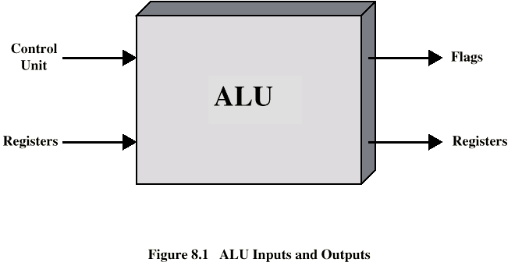
Arithmetic & Logic Unit
Data are presented to the ALU in registers, and the results of an operation are stored in registers.
These registers are temporary storage locations within the processor that are connected by signal paths to the ALU.
The ALU may also set flags as the result of an operation.

Slide 6
Integer Representation
In the binary number system,1 arbitrary numbers can be represented with just the digits 0 and 1, the minus sign, and the period, or radix point.
-1101.01012 = -13.312510
For purposes of computer storage and processing, however, we do not have the benefit of minus signs and periods. Only binary digits (0 and 1) may be used to represent numbers.

Slide 7
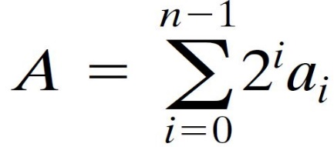
Integer Representation
An 8-bit word can represent the numbers from 0 to 255, including
00000000 = 0
00000001 = 1
00101001 = 41
10000000 = 128
11111111 = 255
In general, if an n-bit sequence of binary digits a_{n-1}, a_{n-2},…a₁, a₀ is interpreted as an unsigned integer A, its value is-

Slide 8
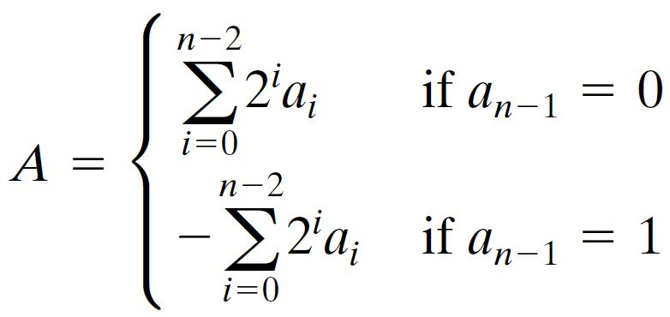
Sign-Magnitude
Left most bit is sign bit 0 means positive 1 means negative.
The simplest form of representation that employs a sign bit is the sign-magnitude representation. In an n-bit word, the rightmost n-1 bits hold the magnitude of the integer.
  +18 = 00010010
  -18 = 10010010
The general case can be expressed as above:

Slide 9
Sign-Magnitude
There are several drawbacks to sign-magnitude representation. One is that addition and subtraction require a consideration of both the signs of the numbers and their relative magnitudes to carry out the required operation.
Another drawback is that there are two representations of 0:
  + 0 = 00000000
  -0 = 10000000 (sign magnitude)
This is inconvenient because it is slightly more difficult to test for 0 than if there were a single representation.

Slide 10
Two’s Compliment
Like sign magnitude, twos complement representation uses the most significant bit as a sign bit, making it easy to test whether an integer is positive or negative.
  +3 = 00000011
  +2 = 00000010
  +1 = 00000001
  +0 = 00000000
  -1 = 11111111
  -2 = 11111110
  -3 = 11111101

Slide 11
Two’s Compliment : Benefit
One representation of zero
Arithmetic works easily (see later)
Negating is fairly easy
  3 = 00000011
  Boolean complement gives 11111100
  Add 1 to LSB 11111101
  +18 = 00010010 (twos complement, 8 bits)
  +18 = 0000000000010010 (twos complement, 16 bits)
  -18 = 11101110 (twos complement, 8 bits)
  -32,658 = 1000000001101110 (twos complement, 16 bits)

Slide 12
Integer Arithmetic
In twos complement notation, the negation of an integer can be formed with the following rules:
Take the Boolean complement of each bit of the integer (including the sign bit).That is, set each 1 to 0 and each 0 to 1.
Treating the result as an unsigned binary integer, add 1.

Slide 13
Integer Arithmetic
+18 = 00010010 (2s comp.)
bitwise comp. = 11101101
+ 1
-------------------------------------------
11101110 = -18
As expected, the negative of the negative of that number is itself:
-18 = 11101110 (2s comp.)
bitwise comp. = 00010001
+ 1
--------------------------------------------
00010010 = +18

Slide 14
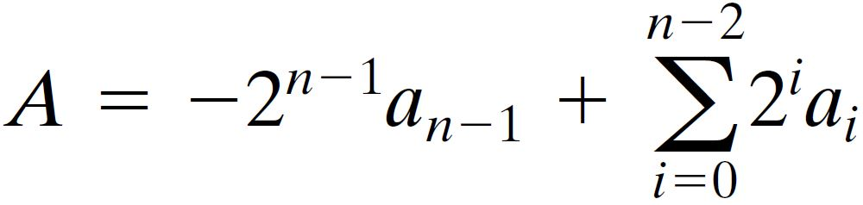
Integer Arithmetic
We can demonstrate the validity of the operation just described using the definition of the twos complement representation in Equation-

Slide 15
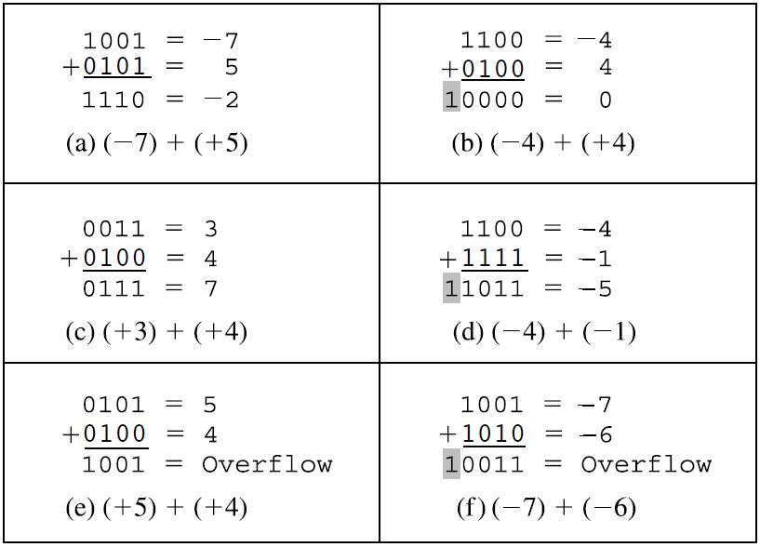
Addition and Subtraction

Slide 16
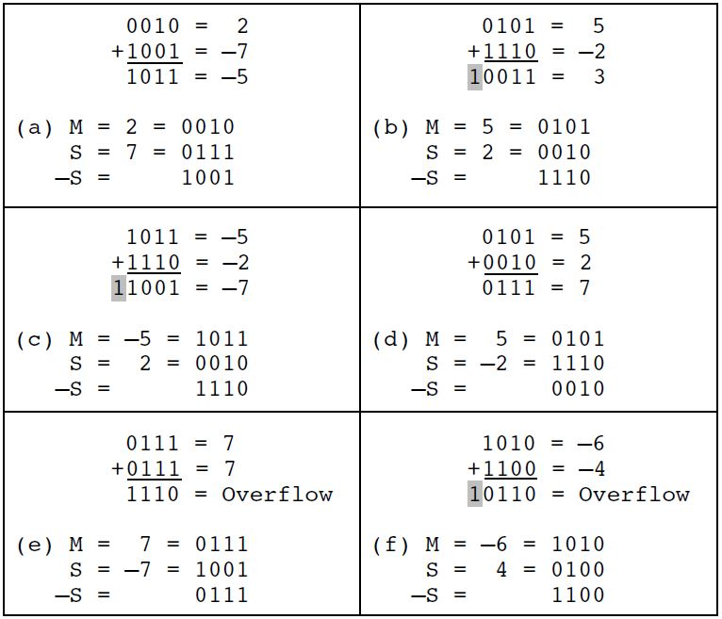
Addition and Subtraction

Slide 17
Multiplication
Several important observations can be made:
Multiplication involves the generation of partial products, one for each digit in the multiplier. These partial products are then summed to produce the final product.
The partial products are easily defined. When the multiplier bit is 0, the partial product is 0.When the multiplier is 1, the partial product is the multiplicand.
The total product is produced by summing the partial products. For this operation, each successive partial product is shifted one position to the left relative to the preceding partial product.

Slide 18
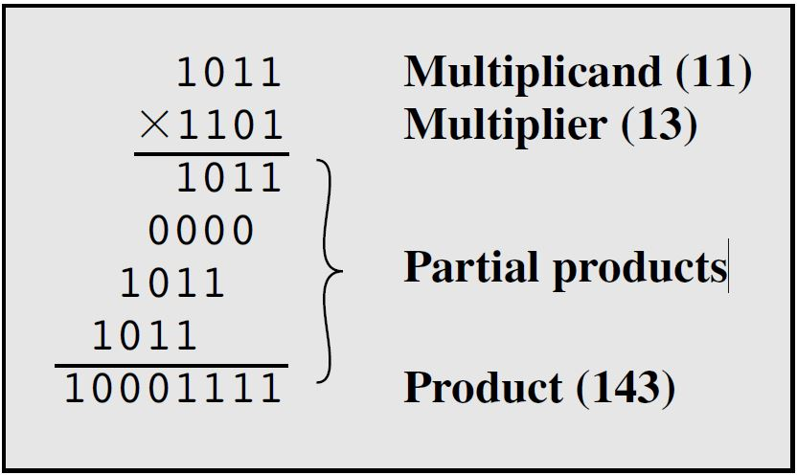
Multiplication
4. The multiplication of two n-bit binary integers results in a product of up to 2n bits in length (e.g.) 11 * 11 = 1001

Slide 19
Question??

Slide 20
Thanks

